Slide 1
Connecting Shiny and MySQL
July 24, 2020

Slide 2
Structure of a Shiny App
A user interface object (UI)
A server function
A call to the shinyApp function

Slide 3
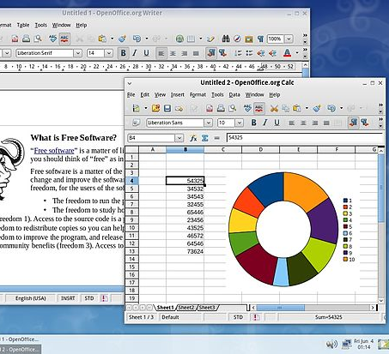
User Interface
This Photo by Unknown Author is licensed under CC BY-SA

Slide 4
Layout
Shiny uses the function fluidPage to create a display that automatically adjusts to the dimensions of your user’s browser window. You lay out the user interface of your app by placing elements in the fluidPage function.

Slide 5

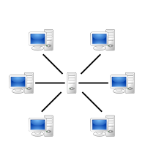
Server function
This Photo by Unknown Author is licensed under CC BY-SA

Slide 6
Making a connection
dbConnect()
R users can integrate SQL Server databases using the DBI package.
The first step is to build a connection string.

Slide 7
Executing a Query
dbGetQuery( con, “codes for operating databases”)
Return the result of a query as a data frame.

Slide 8
Making a disconnection
dbDisconnect()
Generally, it is a good idea to close connections after use.
Discard all pending works
Free resources
Warning*

Slide 9
Connection Summary
Database interaction starts with a connection.
Once I have a connection, then I begin using queries.
The DBI function dbGetquery takes two arguments
1. the connection
2. a query string
Finally, it is good to get in the habit of closing connections

Slide 10
Resources
https://bookdown.org/msharkey3434/ShinyDB_Book/

